Slide 1
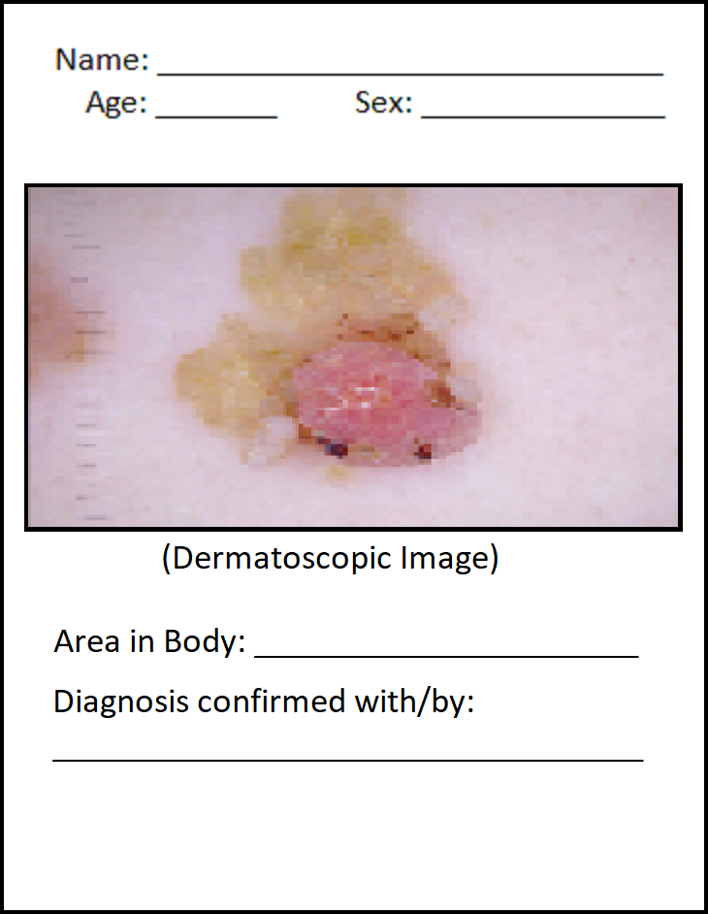
Problem Statement & Success Criterion
Given 10,015 of these filled up forms, can we build a predictive model to accurately diagnose seven distinct pre-cancerous and cancerous skin conditions?
Success is measured as a well-represented confusion matrix
High Accuracy, Precision

Slide 2
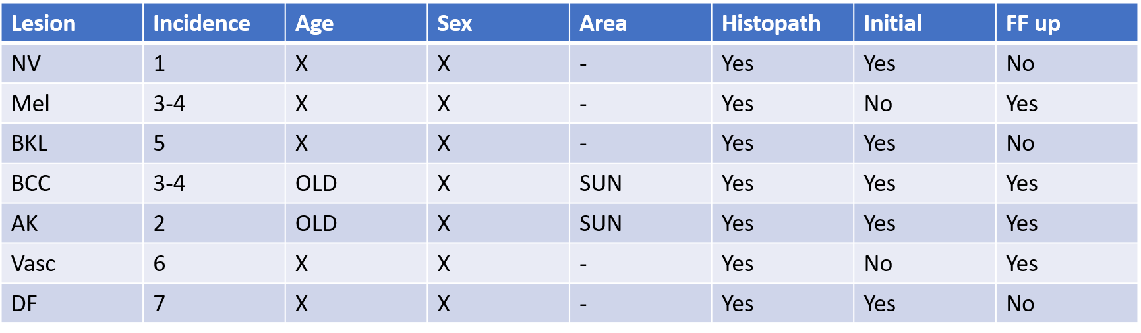
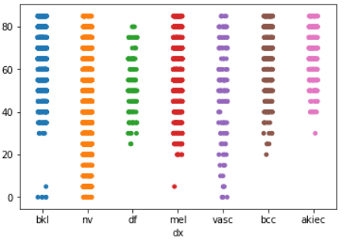
SME Consult
Metadata is consistent with SME’s knowledge of disease distribution
Age distribution according to SME vs Data set Age distribution

Slide 3
Assumptions and Decisions
Data is valid and representative of the naturally-occurring distribution in the population
Decisions:
Model - CNN run first, output used in successive RandomForestry model
Model - stratified Test/Training samples (to account for rare conditions)
Image - cropped at the borders, and resized to 25% of cropped (105x90)
Data - 234 of 10015 (2%) missing/null values were dropped
Data - ‘Sex’ was removed as a feature (℅ SME advice)
Data - Specific ‘locations’ will be used as features in the metadata

Slide 4
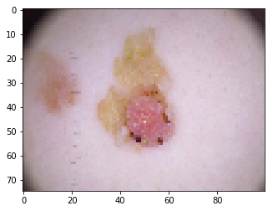
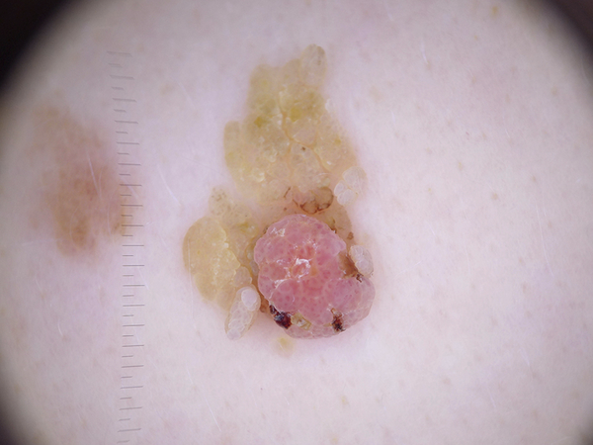
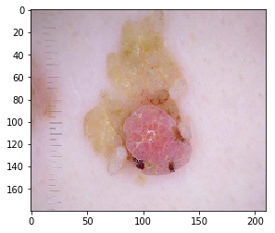
105 x 90 x 3
Original 600 x 450
Cropped 15% left/right, 10% top/bottom
Resize by half (210, 180, 3)

Slide 5
Achievements
Ran 11 different CNN models with varying hyperparameters at 3 Epochs (Kernel size, Resolution, Drop outs, No. of Convolutions, Cropping the Image)
Determined best CNN model
Used CNN outputs in RandomForest model w/ patient’s metadata
Acceptable final accuracy (77.4%)
Distinct 7x7 Confusion Matrix (diagonal is good)

Slide 6
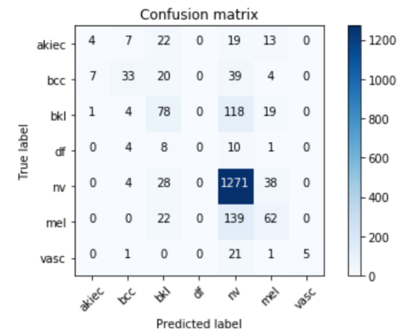
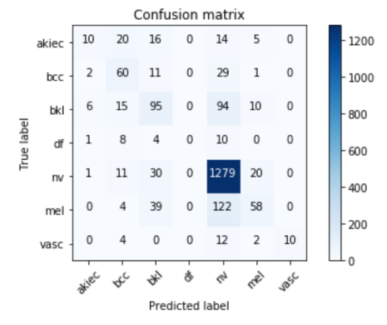
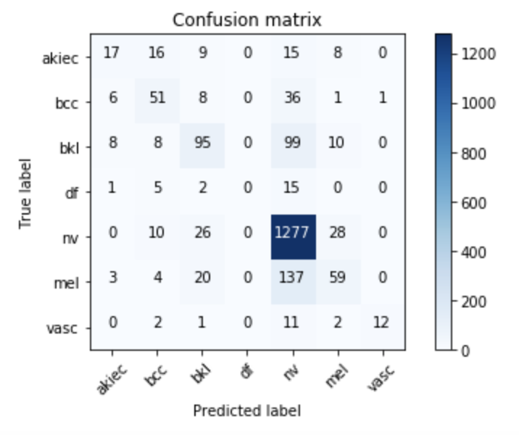
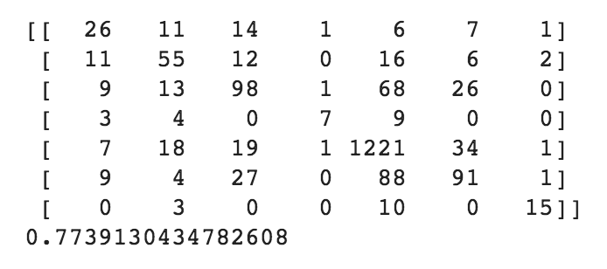
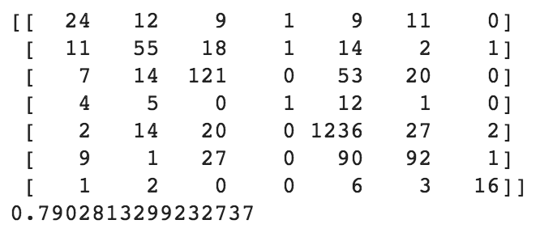
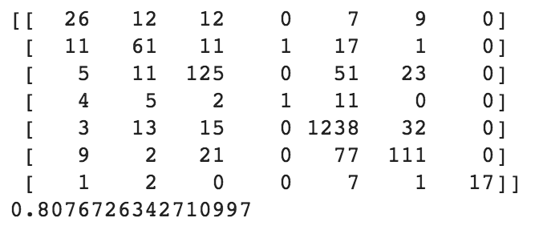
Case 3
Epoch: 10
Epoch: 50
Epoch: 150

Slide 7
Learnings
Integrated two models (CNN → Random Forest)
Modified CNN parameters (Kernel size, Resolution, Drop outs, Convolutions, Cropping the Image)
Exploratory Data Analysis
Resolution affects the model accuracy and classification report
Dropouts help in controlling overfitting
SME consultation increases understanding during data exploration
Working as a team and using each other’s strengths to achieve the output

Slide 8
Next Steps
Run a merge/concatenation of CNN and another classification model with varying hyperparameters
Try more advanced models (ex. ResNet)
Join the competition: https://challenge2019.isic-archive.com/

